Slide 1
LDAP Configuration and Troubleshooting Tips
Russell Kavanagh
Content Management - Server

Slide 2
What is LDAP
LDAP is the acronym for Lightweight Directory Access Protocol, a TCP/IP-based protocol for communication between a client (in this case, Content Server) and a directory server.
An LDAP directory server is a third-party product that maintains information about users and groups.
It has a structure that contains the domain, organizational units, groups, and users.

Slide 3
Why use LDAP
Documentum Content Servers use LDAP directory servers for two purposes:
• To manage users and groups from a central location
• To authenticate users
The configuration can be used to synchronize users with Documentum via the dm_LDAPSynchronization job or to authenticate users that were added manually.

Slide 4
How does it work?
Documentum connects to an LDAP Server via an LDAP Configuration object (dm_ldap_config). This object is created using Documentum Administrator (DA) and is required to allow for LDAP authentication.
The configuration contains a user to bind to ldap, the server name and port, the filters that define which users and groups will be synchronized, as well as attributes used to map users between Directory server and Documentum.
The structure within the directory server is what is used to construct filters to be applied to the LDAP configuration object.
These filters are then used to synchronize and authenticate users with the Directory server.

Slide 5
Supported platforms
The supported LDAP servers are:
SUN - Sun Java System Directory Server
Oracle – Oracle Internet Directory
Microsoft – Active Directory
*Novell eDirectory is not supported

Slide 6
Creating an LDAP Configuration Object
Using DA, navigate to User Management | LDAP and click File New.
On the Info tab, you specify the following:
Name for the config object
Whether to use SSL or not (for secure connections). If using SSL, you must select the cert7.db location and specify the SSL port – default is 636.
What you want to import – users, groups, or users and groups
If you want to rename users and groups upon synch
If you want to deactivate users on synch. This option is not for use with UNIX to Windows environments.
Whether to use this as default configuration or not.

Slide 7
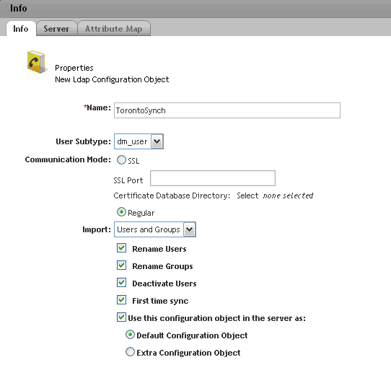
LDAP Configuration: Info Tab

Slide 8
LDAP Configuration: Server Tab
On this tab, you specify the following:
The type of directory server
The bind type. The bind type defines how the client obtains a user’s distinguished name for authentication purposes. If the bind_type attribute is set to bind_search_dn, the client uses the user’s operating system name to obtain the distinguished name from the directory server. If the bind_type attribute is set to bind_by_dn, the user’s distinguished name is obtained directly from the user’s user_ldap_dn attribute. The bind_type attribute defaults to bind_search_dn
The binding name and password. This cannot contain a comma.
Name of server where the directory is setup and the port. The default port is 389. If using SSL, you must still leave this port as the default for the initial handshake and save of the config object. However, it will still use port 636 for communication.
Person and group filters.

Slide 9
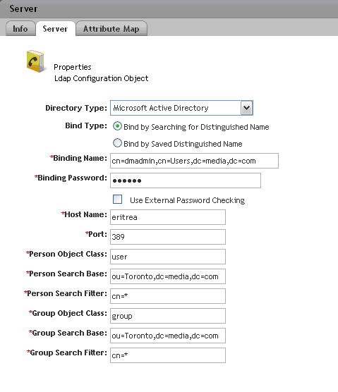
LDAP Configuration: Server Tab

Slide 10
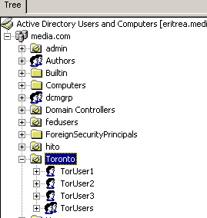
LDAP Configuration: Filters = Directory Server Structure
Using Active Directory, locate the users and groups you want to use to synch with Documentum. Here, I want all users (cn=*) and groups in the Toronto Organizational Unit (ou=Toronto), within the domain controller (media.com).
dc=media
dc=com
ou=Toronto
cn=*

Slide 11
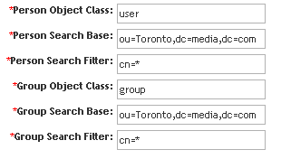
LDAP Configuration: Server Tab
Now back in the LDAP configuration, specify the filters as they coincide with the Directory Server

Slide 12
LDAP Configuration: Server Tab

Slide 13
LDAP Configuration: Attribute Mapping Tab
This tab is used to specify the attributes that are mapped between users in Documentum and users in the Directory Server.
The three defaults are as follows:
user_name - maps to cn
user_os_name – maps to sAMAccountName or uid
user_address – maps to email
You need to ensure that these mappings are correct and that the values for these attributes match between DCTM and Directory Server. Note that user_os_name can map to either sAMAccoutName or uid. sAMAccountName is the name of the attribute on Windows Active Directory while uid would be used in UNIX Directory Servers.
*You can also define additional mappings should it be required.

Slide 14
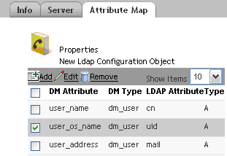
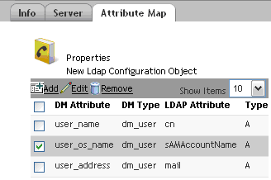
LDAP Configuration: Attribute Mapping Tab
UNIX
Windows

Slide 15
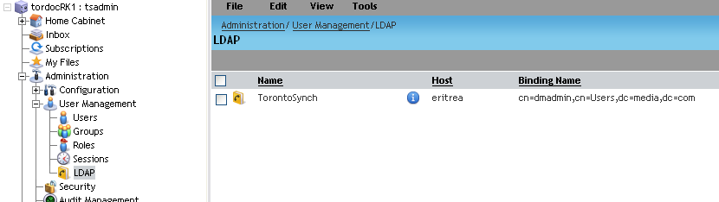
LDAP Configuration: Complete
Once complete, click Finish to complete the save of the LDAP configuration object.

Slide 16
LDAP Configuration: Complete
When the LDAP configuration is saved, the binding user’s password is saved in a file called ldap_ldapconfigid.cnt under the directory $DOCUMENTUM\dba\config\docbase_name
This file contains the encrypted password. When you run the job from DA or from a command line, this file is used to retrieve the bind user’s password. If this file is missing or not accessible, the job will fail.

Slide 17
LDAP Synchronization Job
Content Server uses the dm_LDAPSynchronization job to synchronize the entries in the directory server and the repository.
The dm_LDAPSynchronization job updates the repository to match the entries in the directory server. This is a one-way operation. Changes in the directory server are propagated to the repository. Changes in the repository are NOT propagated to the directory server.

Slide 18
LDAP Synchronization Job
The job can perform the following operations
• Import into the repository any new users and groups in the directory server.
• Rename in the repository any users and groups whose names are changed in the directory server. For users, the renaming occurs if a change is detected in the LDAP attribute to which the user’s user_name attribute is mapped. For groups, renaming occurs if a change is detected in the cn (common name) to which the group’s group_name attribute is mapped.
• Inactivate users in the repository if they are deleted in the directory server.
If you are using Netscape iPlanet Directory Server, Oracle Intranet Directory Server, or Microsoft Active Directory with a repository on a Windows host, the job can perform all operations. When using iPlanet, you must enable the changelog feature to use the renaming and inactivation operations. The renaming and inactivation operations are not supported on Microsoft Active Directory for repositories on UNIX hosts.

Slide 19
LDAP Synchronization Job
When the job runs successfully, the user is propagated to Documentum and the attributes mapped within the LDAP configuration are populated.
user_name, user_os_name, user_address
In addition, the following attributes are updated:
user_source attribute is set to LDAP
user_ldap_dn is set to the location in the directory where this user resides
user_login_domain is set to the name of the default ldap configuration object.
*If you manually add users without synchronizing and you are using Bind by Saved in the configuration object, the above attributes must be manually populated.

Slide 20
LDAP Synchronization Job
The first time the LDAP job is launched, it performs a full synchronization. At this time, the a_last_run attribute of the dm_ldap_config object is set to the current date and time. Any subsequent run of the job will do an incremental sync unless this attribute is cleared (null).
To force a full sync, you must clear this attribute using API, or run the job from a command line using full_sync set to True
API:
API>retrieve,c,dm_ldap_config
API>set,c,l,a_last_run
SET>
API>save,c,l

Slide 21
LDAP Synchronization Job
To run the LDAP Synchronization from a command line, use the following syntax based. These should be launched from the DM_HOME/bin directory.
Content Server 5.3:
java com.documentum.ldap.LDAPSync -docbase_name repositoryname
-user_name superuser_login -method_trace_level integer -full_sync true
Content Server 5.2 and 5.2.5:
java com.documentum.ldap.LDAPSync -bDocbaseName -uDocbaseAdminUser -pPassword -t10 -ntrue
Content Server 5.1 and lower:
java -classpath
"../classes:../classes/com/documentum/ldap/ldapfilt.jar:../classes/com/documentum/ldap/ldapjdk.jar:$DOCUMENTUM_SHARED/dctm.jar" com.documentum.ldap.LDAPSync -bDocbaseName -uDocbaseAdminUser -pPassword -t10 -ntrue

Slide 22
LDAP Synchronization Job - Troubleshooting
To troubleshoot the LDAPSynchronization job, you can examine the regular job
report and the trace_ldapsync_dfc.txt and trace_ldapsync_dmcl.txt files. The trace files are generated regardless of whether tracing is turned on for the job. These files are stored in the %DOCUMENTUM%\share\temp\ldif\<docbase_name>
($DOCUMENTUM/share/temp/ldif/<docbase_name>) directory.
The job also creates the regular job trace file if the method_trace_level argument in the job is set to a value greater than zero. Both the report and log file can be easily accessed from Documentum Administrator. The report will often contain useful messages to indicate the exact cause of a problem. However, in some instances, you will just receive a message that the job failed with “No Error”.

Slide 23
LDAP Synchronization Job - Troubleshooting
The following steps can assist in troubleshooting errors related to the LDAP job failing with no descriptive error message
1) The LDAP job runs on the JAVA Method Server so the first thing is to ensure that this service is started. You can also test the JMS by using the value of the app_server_uri of the dm_server_config object to access the web page.
2) Using esg44359, verify that the method verb and job properties are correct:
method_verb com.documentum.ldap.LDAPSync
run_as_server T
use_method_content F
method_type java
use_method_server T

Slide 24
LDAP Synchronization Job - Troubleshooting
3) Try running the job from a command line. This eliminates issues with DA or the JMS.
4) Verify that the path to java is referenced in the PATH environment variable for Windows platforms (Program Files\Documentum\java\1.4.2\bin
5) On UNIX environments, ensure that JAVA_HOME is defined correctly and that this is also referenced in the PATH environment variable.
6) The ldap classes are referenced in the manifest file located in dctm-server.jar. Ensure that this file is located in Documentum\product\5.3 and also referenced in the CLASSPATH environment variable. The actual classes are located in the Documentum\product\5.3\lib directory.

Slide 25
LDAP Synchronization Job - Troubleshooting
7) Check the java method server logs for errors (located in DM_HOME\tomcat\logs)
8) To check issues with the configuration itself, dump the dm_ldap_config
API>retrieve,c,dm_ldap_config
API>dump,c,l
This will show the attributes that are mapped, the filters, the binding user, etc.

Slide 26
LDAP Synchronization Job – Common Errors / Issues
Warning in LDAP Report: “Nothing to synchronize because the ldap_config_id in dm_server_config is NULL”
Refer to esg83692
Error when saving an LDAP config object: “MSG_PASSWORD_SAVE_FAILED” Refer to esg83700
Error when running LDAP job: Authentication failed for user ‘<install owner>’ with docbase ‘>docbasename>’
Refer to esg83701

Slide 27
LDAP Synchronization Job – Common Errors / Issues
Error synching users from Active Directory: “ javax.naming.SizeLimitExceededException”
This error indicates an issue with settings on the Directory Server. In order to perform efficiently (and to prevent denial-of-service attacks) directory servers often impose limits on the amount of resources allocated to satisfying a particular LDAP request. When this limit is exceeded, the LDAP job will fail.
In such cases, you will find that many of the users were synchronized but some were not.
To resolve this issue, the LDAP Administrator must increase the size limit. Refer to esg22545 for additional information

Slide 28
LDAP: Useful Support Notes
The following are frequently used support notes related to LDAP:
esg80502: Setting default folder for users synchronized by LDAP
esg44495: LDAP Proxy – not supported but information regarding the setup
esg22545: Configure the max page size
esg74932: How to run the LDAP synchronization job manually from a command line.
esg44359: Why does the LDAP job fail after upgrade to 5.3
esg83692: Nothing to synchronize because the ldap_config_id in dm_server_config is NULL

Slide 29
LDAP: Useful Support Notes
esg83700: Error when saving an LDAP config object: “MSG_PASSWORD_SAVE_FAILED”
esg83701: Error when running LDAP job: Authentication failed for user ‘<install owner>’ with docbase ‘>docbasename>’
esg44359: verifying the method verb and job properties

Slide 30


